Slide 1


Electronic Care
Presented by
N.Ravindranath - AP21110010621
B.Krishna - AP21110010619
K.Sashank - AP21110010595
B.Nitya - AP21110010648

Slide 2


AGENDA
Introduction
Main interface
List of modules
UI of E care
Conclusion

Slide 3

Introduction
Java Swing application for an e-care management system. The application consists of a main frame with three buttons: "USER LOGIN," "ADMIN LOGIN," and "REGISTRATION." Clicking on these buttons opens different frames for user login, admin login, and registration, respectively.

Slide 4
Main Interface
MAIN MENU
User Login
Admin Login
Registration
@reallygreatsite

Slide 5

LIST OF MODULES
->ACKNOWLEDGEMENT
->Complaint User
->Login User
->View Admin
->Login Admin
->View Entry of solutions
->Registration
->Main Frame
->Db

Slide 6
Registrations User Login
The `userLogin` class is similar to the `adminlogin` class but represents the user login frame, where users can enter their username and password to log in.
The `Registration` class represents the registration form frame, where users can enter their UID, password, email, phone number, and location. It includes a "SAVE AND BACK" button to save the registration details and return to the main frame.

Slide 7
Admin login
Complaint module
Acknowledgement
This class represents an admin login form. Admin users can enter their username and password to log in and access the admin view.
This class represents a complaint object with attributes like token ID, device type, description, issue, and specs. It overrides the `toString()` method to provide a string representation of the complaint.
This class represents an acknowledgment window that is displayed after a successful submission. It shows a success message and a token number.

Slide 8
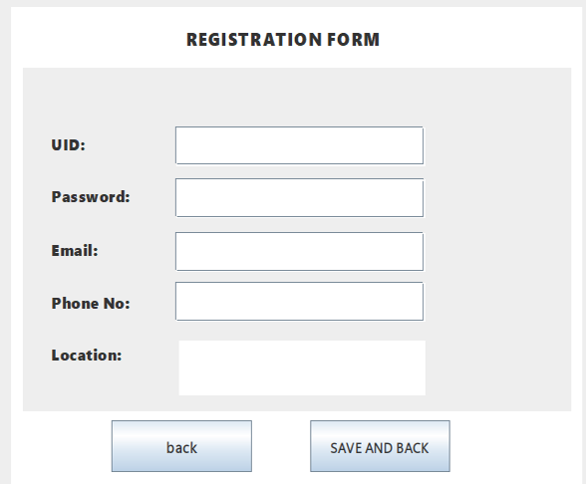
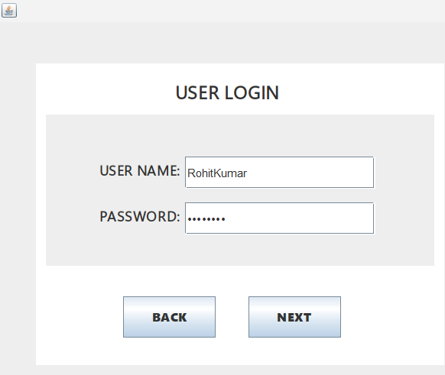
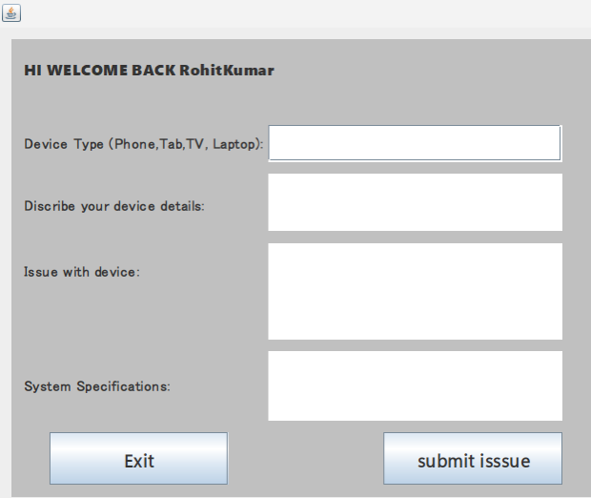
UI of E-care
Registration form
UserLogin
Complaint Module

Slide 9

Our Application helps user to resolve their Quieres regarding any electrical Issues where user can submit their Qieres from complaint interface and admin can view the users complaint by the specific token number generated by user interface after submitting the complaint and admin can solve the users Querey.

Slide 10
Thank You

